Slide 1
Overview of language
What?
Method of communication, either spoken or written, consisting of the use of words in a structured and conventional way
Note
Point-of-view: Speaker’s or writer’s
Content: their thoughts

Slide 2
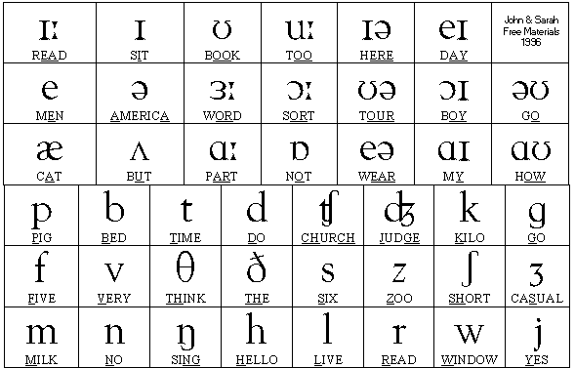
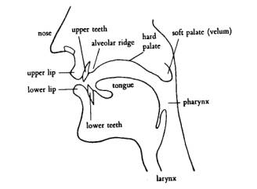
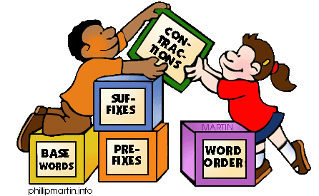
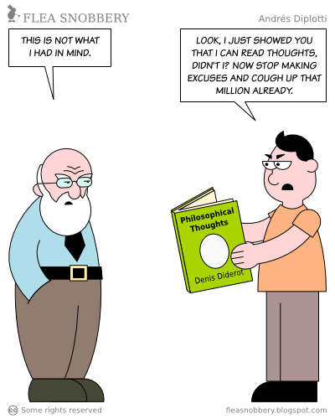
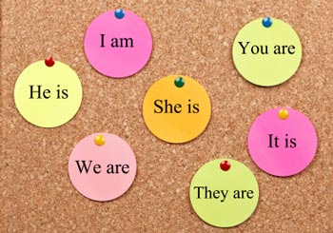
3 parts of language
Language
Phonetics
Phonology
(Sound)
Grammar
Morphology
(Structure)
Semantics
Pragmatics
(Meaning)

Slide 3
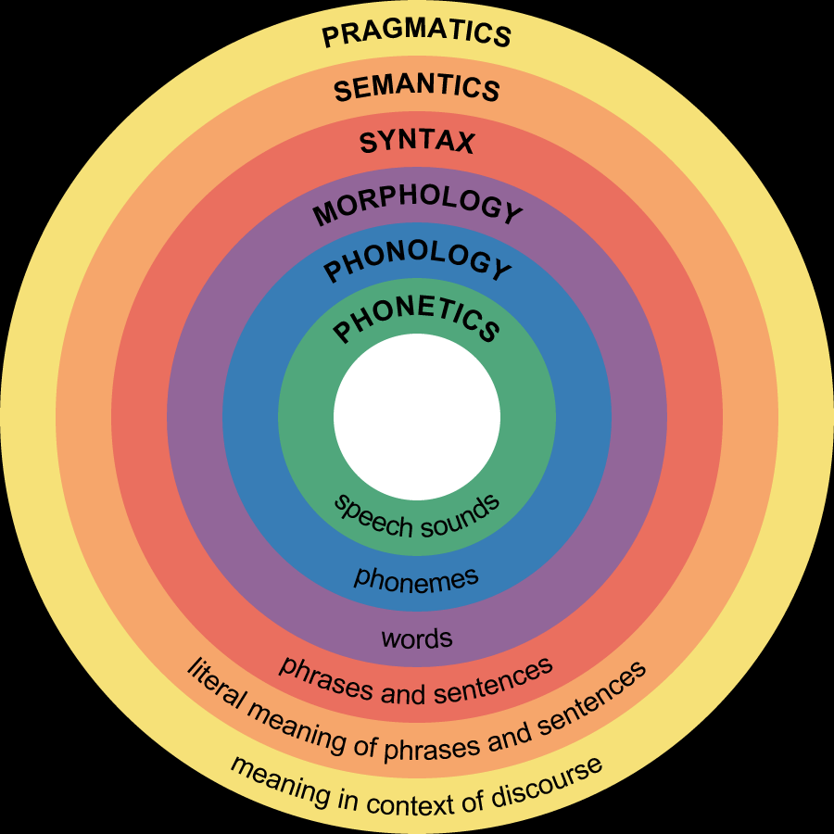
3 parts of language

Slide 4
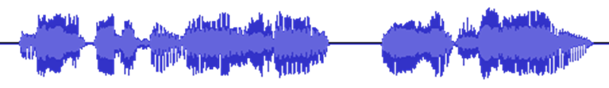
Levels of linguistic structure
Sound
Phoneme
ð iː z b juː t ə f ʊ l w ɪ m ɪ n s ɛ d w iː w ɜː t r uː m ɛ n
Morpheme
These beauti-ful women said we were true men
Word
These beautiful women said we were true men
Phrase
These beautiful women said: “We were true men.”
Clause
C(These beautiful women said: “C(We were true men.)”)
Sentence
These beautiful women said: “We were true men.”
Meaning
?

Slide 5
Word structure
 | Prefix (Optional) | Root / Stem (Required) | Suffix (Optional)
Happy |  | Happy
Unhappy | Un- | happy
Happily |  | Happi | -ly | Suffixes can require some spelling changes in root
Unhappily | Un- | happi | -ly | Prefix and suffix can be added together
Industry |  | Industry
Industrial |  | Industri | -al
Industrialize |  | Industri | -al-ize | More than 1 suffixes can be added
Industrialization |  | Industri | -al-iz-ation
Change |  | Change
Non-interchange | Non-inter- | change |  | More than 1 prefixes can be added
Lists of common: prefixes, roots & prefixes, suffixes

Slide 6
Word inflection
What is it?
The modification of a word to express different grammatical categories such as tense, mood, voice, aspect, person, number, gender and case
The inflection of verbs is also called conjugation
The inflection of nouns, adjectives and pronouns is also called declension
http://en.wikipedia.org/wiki/Inflection
English is an inflected language

Slide 7
Inflection examples
Inflectional suffixes
Number
I play -> She plays
Tense
I play -> I played -> I am playing
Number
A cat -> Two cats
Case (Genitive)
Lady’s handbag
Gender
Lion -> lioness
Verb
Determiner
Noun
Number
This hat -> these hats
That hat -> those hats
Adverb
Pronoun
Comparison
- Jim ran fast -> Tony ran faster -> Paul ran the fastest.
- I play well -> She plays better -> He plays the best.
Adjective
Number
This is -> These are
Case
She loves herself.
Give her hers.
Comparison
- Betty is short -> Sarah is shorter -> Eva is the shortest.
- I am good -> He is better -> She is the best.

Slide 8
Word classes
Open class
(content / lexical / autosemantic words)
Closed class
(Function / structure words)
Verb
Determiner
Noun
Conjunction
Adverb
Numeral
Preposition
Adjective
Interjection
Pronoun
Have inflection
Building blocks
The glue

Slide 9
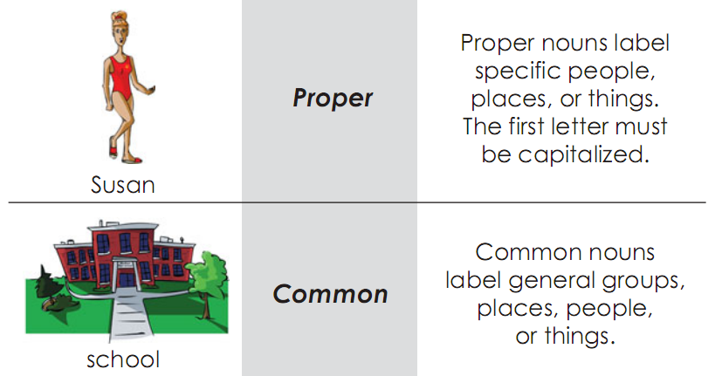
Nouns
Unique things
Other things
A noun refers to ‘things’ in the broadest sense (person, place, thing, idea, quality, action, etc.). If we have a noun for something, it implies that we view it as a ‘thing’.

Slide 10
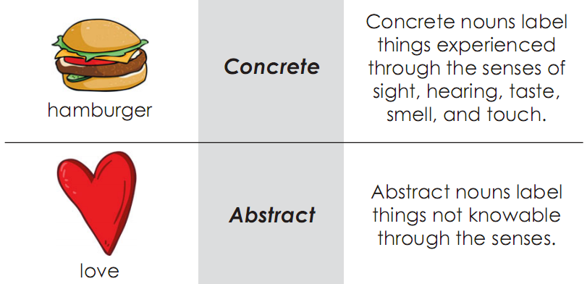
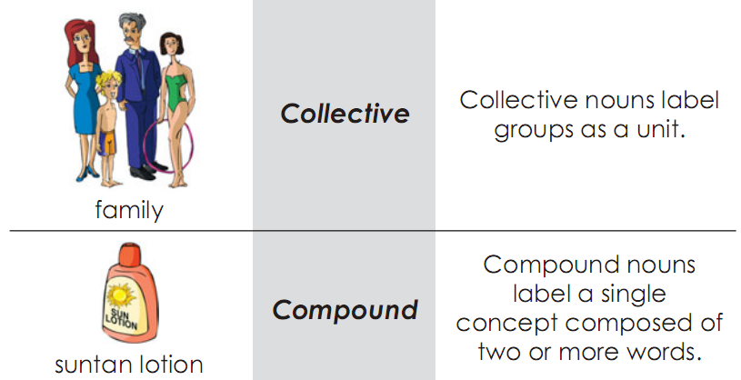
Common nouns
See:
- A sample list: http://users.tinyonline.co.uk/gswithenbank/collnoun.htm
- Origin: http://www.englishleap.com/grammar/collective-nouns
- Agreements: here
Perceivable
Others
A noun can belong to more than one group.
E.g. suntan lotion is both a common and a concrete noun, as well as a compound noun.

Slide 11
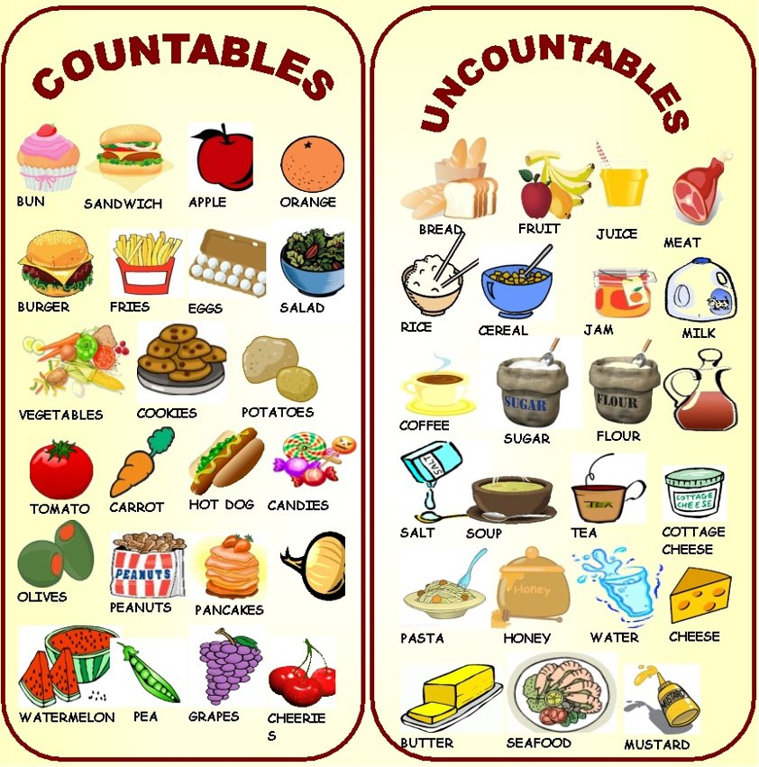
Common nouns
A noun can be classified as countable or uncountable (mass).
- Some nouns may be both depending on the context. E.g. I want some cake. and I have 6 cakes.
- Some mass nouns can be used as countable nouns to mean ‘a number of kind/portion of objects’. E.g. five cheeses, a beer.
- Mass nouns like flour and bread can only be made countable by prefixing some expression of measurement. E.g. six spoonful of flour.

Slide 12

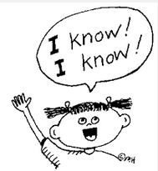


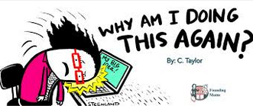

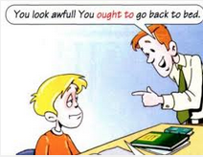

Verb classes
Transitive (V + O) I love you.
Intransitive (V without O) I sleep.
MORE
Lexical love, sleep, run, know, …
(Refer to actions, events and processes)
Dynamic (be + -ing) I am running.
Static (Never -ing) I know.
Linking (Tell the state of being) She is cute.
Verb
Primary Be, have, do
Auxiliary
(Perform grammatical functions or express speaker’s mood)
MORE
Modal Will/would, shall/should, may/might, can/could, must, ought to

Slide 13
Verb forms - Lexical
Infinitive (Dictionary) | 3rd person singular present tense | Other person present tense | Present participle | Past tense | Past participle
V | V-s/es | V | V-ing | V-ed | V-ed
(To) test | Tests | Test | Testing | Tested | Tested
(To) play | Plays | Play | Playing | Played | Played
(To) save | Saves | Save | Saving | Saved | Saved
(To) tie | Ties | Tie | Tying | Tied | Tied
(To) fly | Flies | Fly | Flying | Flied | Flied
(To) watch | Watches | Watch | Watching | Watched | Watched
(To) input | Inputs | Input | Inputting | Inputted | Inputted
(To) build | Builds | Build | Building | Built | Built
(To) run | Runs | Run | Running | Ran | Run
(To) go | Goes | Go | Going | Went | Gone
- Verbs are irregular if they have irregular past tense and past participle forms. - Except for some irregular verbs, past tense and past participle forms are the same.

Slide 14
Verb forms - Auxiliary
Infinitive (Dictionary) | 3rd person singular present tense | Other person present tense | Present participle | Past tense | Past participle
(To) be | Is | Am/Are | Being | Was/Were | Been
(To) have | Has | Have | Having | Had | Had
(To) do | Does | Do | Doing | Did | Done
Will | Will | Will |  | Would
Shall | Shall | Shall |  | Should
Can | Can | Can |  | Could
May | May | May |  | Might
Must | Must | Must |  | Must
Ought to | Ought to | Ought to |  | Ought to
- All primary auxiliaries have irregular forms, except for present participle form. - All modal verbs only have 2 different forms for present and past tenses. They do not have infinitive or participle forms.

Slide 15
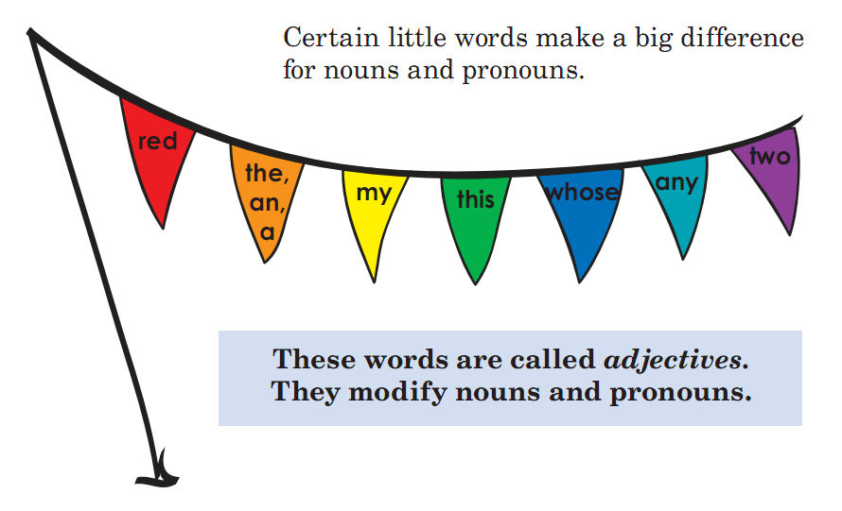
What are adjectives?

Slide 16
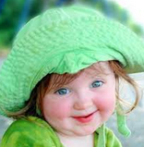
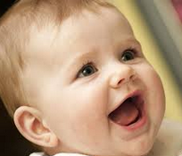
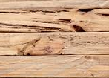





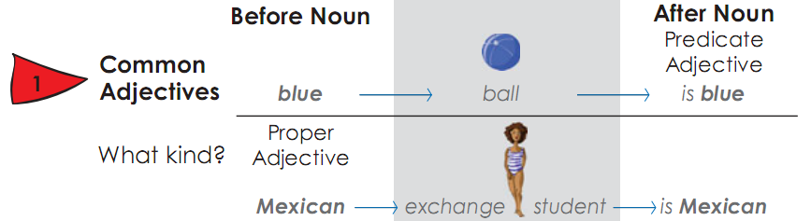
Adjective classes
Careful -> more careful -> the most careful
Cute -> cuter -> the cutest
Which is cuter?
Gradable careful, cute …
Non-gradable wooden, shut …
Adj
See Determiners & Numerals
Limiting (help to identify)
Descriptive (specify size, shape, color, etc.)
Common Green, sunny
Proper Vietnamese, Mexican
Modifying (placed before the noun it describes)
Predicative (come after the linking verb)
Noun

Slide 17
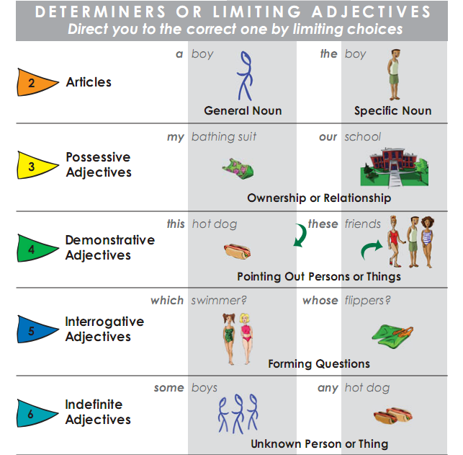
Determiners
Determiners indicate that a noun follows
Identifiers
Quantifiers
(express indefinite quantity)
a lot of
few
little

Slide 18
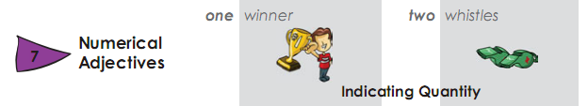
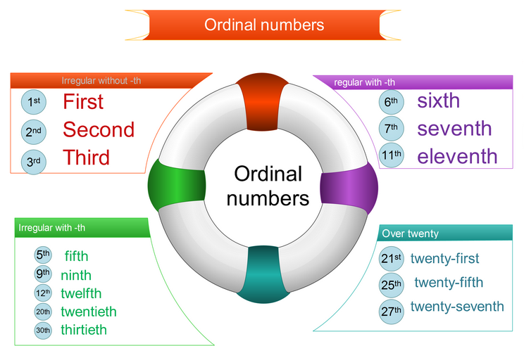
Numerals
Cardinal numbers
Used to:
- Count things: 3 dogs
- Give your age: 10 years old
- Give your phone number
- Give years: 2015
Used to:
- Give a date: My birthday is on the 27th of January.
- Put things in a sequence or order: Liverpool came second in the football league last year.
- Give the floor of a building: on the tenth floor.
- Have birthdays: his twenty-first birthday
http://changingminds.org/techniques/language/speech_parts/cardinals_ordinals.htm
https://www.ego4u.com/en/cram-up/vocabulary/numbers/cardinal
http://www.vocabulary.cl/Basic/Numbers.htm

Slide 19
Adverb classes
Order: M -> P -> T (alphabetically increasing)
More
Adverb of affirmation & negation
Adverb of
degree
(To what extent?)
Adverb of manner
(How?)
Adverb of
place/space
(Where?)
Adverb of
time
(When? How long? How often?)
More
More
More
Yes, a very lovely singer sang the song very well there yesterday.
However, she didn’t often do that well.
Adverb of
conjunction
- Adverbs add circumstantial information about the mentioned action, event or process, or intensify an adjective or another adverb.
- For further reference:
http://www.englishmirror.com/english-grammar/adverb.html
http://www.edufind.com/english-grammar/adverbs/
More

Slide 20
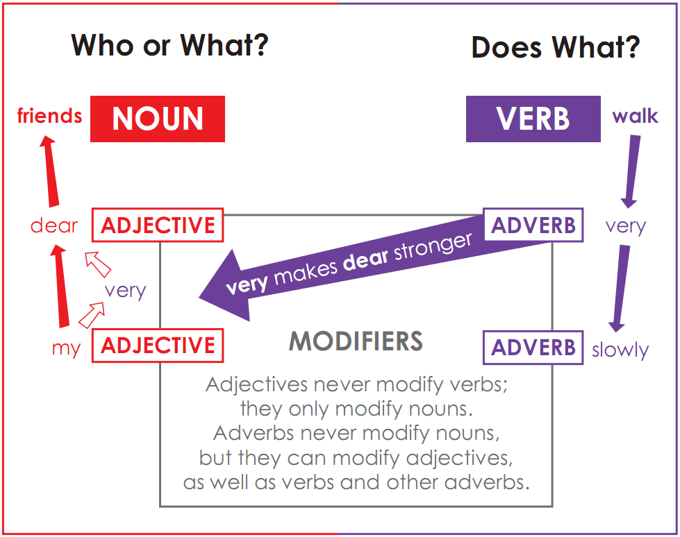
Adverbs vs. Adjectives

Slide 21
Pronoun classes
I know him. I know myself.
This is my hat. That is yours.
Number | Person | Personal (Subjective) | Personal (Objective) | Reflexive | Possessive | Possessive adjective
Singular | 1st | I | Me | Myself | Mine | My
 | 2nd | You | You | Yourself | Yours | Your
 | 3rd | She He It | Her Him It | Herself Himself Itself | Hers His Its | Her His Its
Plural | 1st | We | Us | Ourselves | Ours | Our
 | 2nd | You | You | Yourselves | Yours | Your
 | 3rd | They | Them | Themselves | Theirs | Their
Pronouns have the main function of substituting for nouns, once a noun has been mentioned in a particular text.

Slide 22
Pronoun classes
Interrogative
Also called interrogative adjective
Relative
Who were you talking to?
What is the time?
Which train are you catching?
Which is yours?
Why did you do that?
How is he?
How old is he?
The boy who has lost his ball…
The boy whom I met…
The boy that I met…
The boy whose hat was red…
The table which I bought…
The day when I was still a man…
The place where you were born…
Also called interrogative adverb
Also called relative adverb
Demonstrative
Demonstrative
Infinite
This is a good idea.
These are good ideas.
That is an interesting point.
Those are interesting points.
What are these / those?
All is yours now.
Something is better than nothing.
Hi everyone.
Many know I am innocent.
A few of you have gone.
Pronouns have the main function of substituting for already-mentioned nouns. In questions, pronouns can also substitute for adjectives and adverbs.

Slide 23
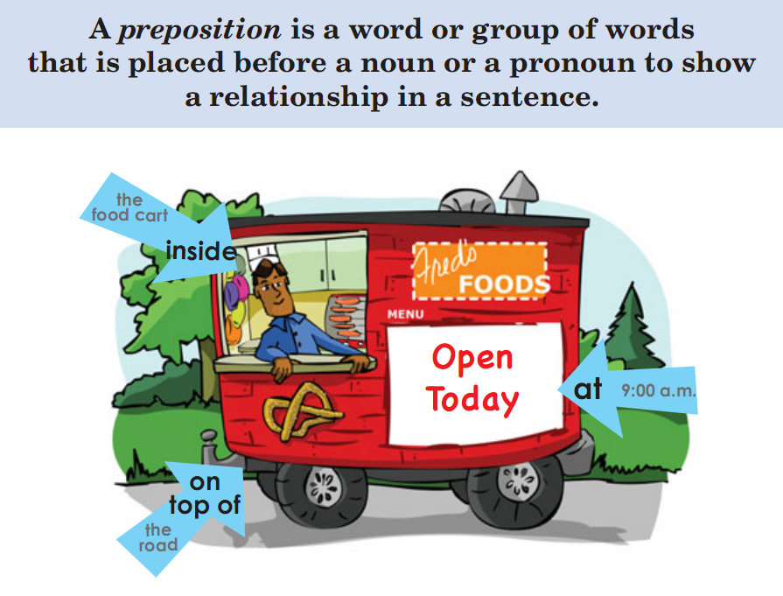
Prepositions

Slide 24
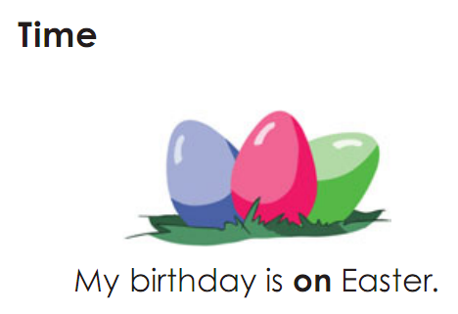
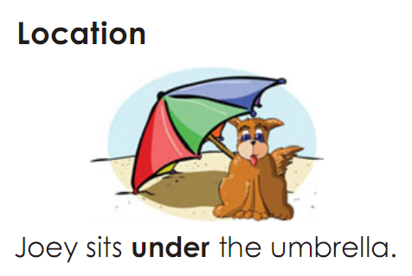
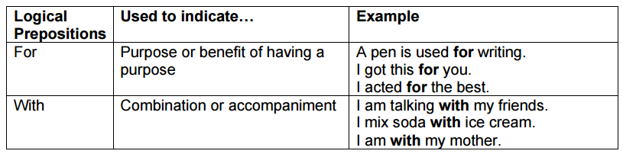
Preposition classes
M
O
R
E

Slide 25
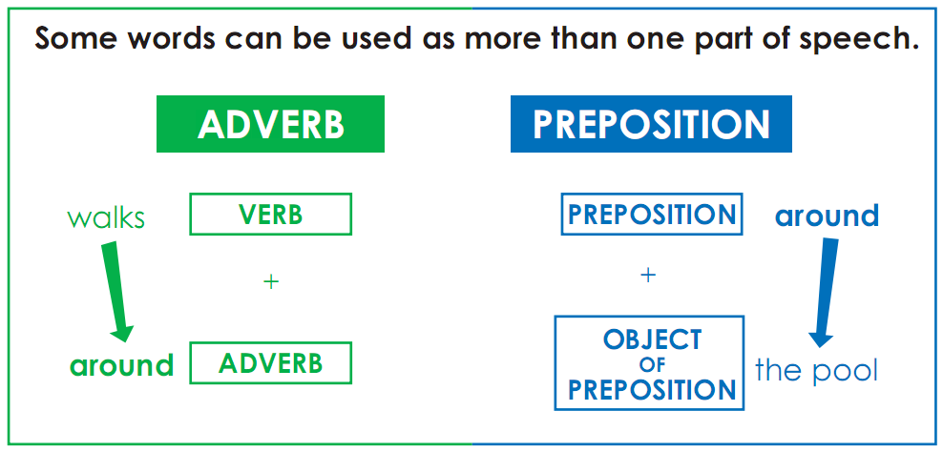
Prepositions vs. Adverbs
He came by the office in a big hurry. (by = preposition)
He came by his fortune honestly. (by = particle)
She turned up that street. (up = preposition)
She turned up something new. (up = particle)

Slide 26
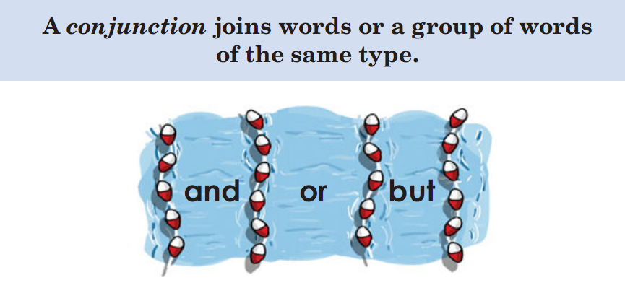
Conjunctions

Slide 27
Conjunction classes
Coordinating
Subordinating
Anna and Jake
Green or pink
Ben walks or takes the bus.
He did that for Jake and for Maria
I went to the pool, and she went to school.
He will come when he is ready.
He will be wherever you are.
He cannot come, because he is ill.
If I knew that, I would not let it happen.
MORE

Slide 28
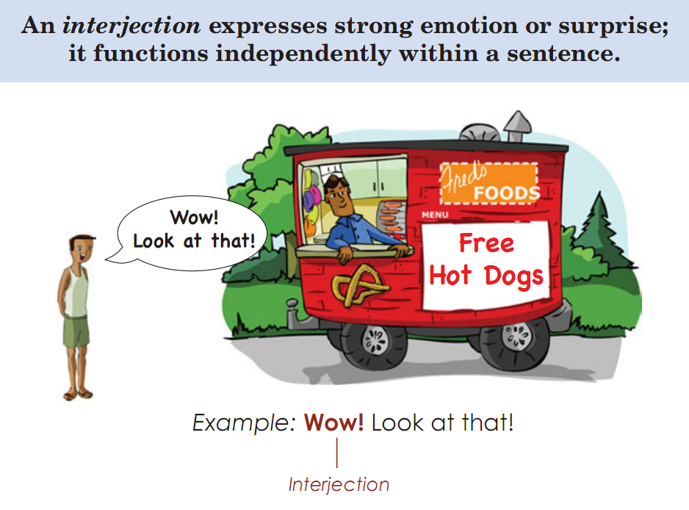
Interjections
hiểu em
hiểu em
hiểu em

Slide 29
Types of phrase
Auxiliary + Lexical
- Have been playing
- Must know
Pre-mod + Head + Post-mod
- Her first attempt to fly a plane
- A charming small round old writing desk
Verb Phrase
Preposition + NP
In the dark
Through a lovely mountain
In contrast
Noun Phrase
Prepositional Phrase
Adverb Phrase
Adjective Phrase
Adverb + Head
- Amazingly well
- Extremely carefully
Adverb + Head + Post-mod
- Very anxious about Jim’s health
- Beautifully cool
Sentence
The little girl, confident in her ability, is playing amazingly well in the dark.

Slide 30
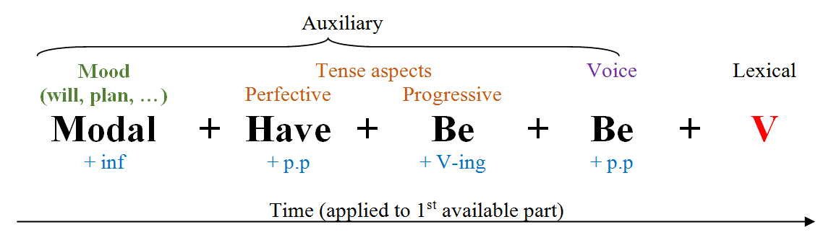
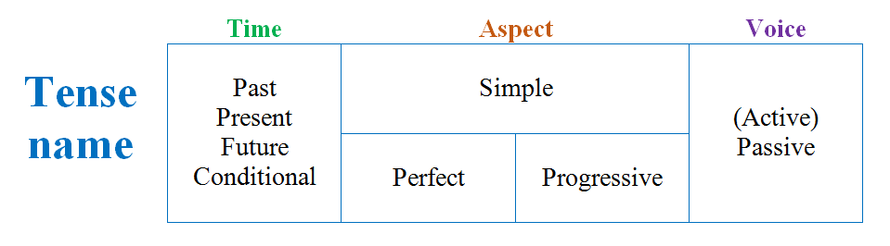
Verb phrase & Tense
Optional
Required

Slide 31
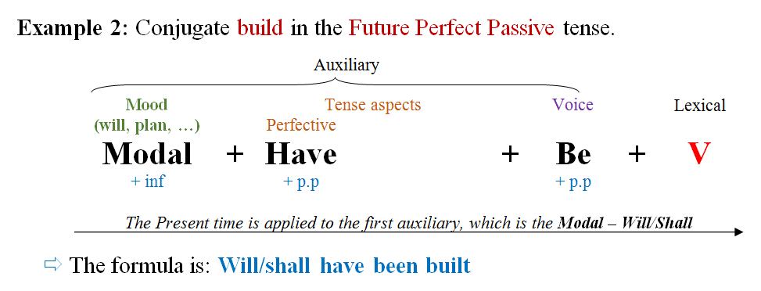
Verb phrase & Tense

Slide 32
Verb phrase - Operator
If there is no auxiliary, then DO will be the operator.
E.g. He walks away, doesn’t he? Does he walk? He didn’t walk.
If any, the operator is marked for tense. Otherwise, the lexical verb is.
E.g. He is coming. She walks.
1st auxiliary = OPERATOR
The operator is able to take contrastive stress.
E.g. He IS coming. She HAS been seen.
The operator changes places with the subject in most questions and inversions.
E.g. Is he coming. Does she walk?
The operator is repeated in a tag question.
E.g. He is coming, isn’t he?
Not is placed immediately after the operator. Not can be contracted and attached to the operator.
E.g. It will not be needed. He didn’t come.

Slide 33
Verb phrase – Final notes
Besides ‘do’, we also have ‘let’, ‘need’, ‘dare’
Let it go! Need I? Daren’t you say?
After an adverb of time (e.g. when, while, before, after, as soon as, etc.), we use a present tense instead of a future tense
I will have done it when you arrive here tomorrow.
Types of verb phrases
Finite: He has come from USA.
Non-finite: I want to go home, Going along the road, Kicked by a boy

Slide 34
Structure of N phrase
Pre-modification (Optional) | Head (Required) | Post-modification (Optional)
 |  | Adjective phrase
 |  | Adverb phrase
 |  | Relative clause
 |  | Non-finite clause
 |  | Prepositional phrase
All these 5 charming country | cottages | around that lake
PIQAN

Slide 35
Pre-modification
Pre-determiner
What, both, all, fraction numerals
E.g. one third of the cake
Quantifier
Ordinal + Indefinite + Cardinal
E.g. The first few thousand men
PIQAN
Identifier
Article (a, an, the)
Demonstrative (this, that)
Possessive (my, your, Jim’s)
E.g. a book, this car, my name
Noun modifier
E.g. Postage stamps, shop windows
Adjective
OSHACOMPD
One third of my first few thousand beautiful cable cars

Slide 36
Pre-modification – PIQAN
Age
Old / middle-aged
Present Participle
Writing/ Dining
Size
Big / long / wide
Origin
Vietnamese
OSHACOMPD
Opinion
Great / Beautiful
Color
Blue / reddish
Material
Cotton / steel
Denominal
Medical / social
Shape
Round / square / Pointed
Your first three beautiful long pointed ancient blue Vietnamese steel writing sticks
Your baby’s last five very cute and adorable sleeping facial expressions

Slide 37
Pre-modification – Simple version
Age
Old / middle-aged
Cardinal
Two / three
Purpose
Sport / Dining
Possessive
Your / Jim’s
Size
Big / long / wide
Origin
Vietnamese
APOCOSHACOMP
Article
The / A / An
Opinion
Great / Beautiful
Color
Blue / reddish
Material
Cotton / steel
Ordinal
First / second
Shape
Round / square / Pointed
Your first three beautiful long pointed ancient blue Vietnamese steel sport sticks

Slide 38
Post-modification – Adjective, Adverb
Pre-modification (Optional) | Noun (Required) | Post-modification (Optional)
The fastest | man | alive
 | Somebody | brave
 | Something | strange
 | Something | very strange about him
 | Blood | royal
 | Heir | apparent
The | room | above
The | room | above us
The nice | time | before
The nice | time | before this one
The nice | time | right before this one
Adjective post-modification is found usually with indefinite pronouns as head
Adjectives do not normally come after nouns, except in a few set phrases
Adverb post-modification is more common than adjective one. Typically, it can be regarded as reduction of a prepositional phrase.

Slide 39
Post-modification – Relative clause
Pre-modification (Optional) | Noun (Required) | Post-modification (Optional)
The | man | who came here yesterday
 | He | who hesitates
 | Somebody | (who) you know
 | Something | (that) you know
The | lady | whose car was stolen
The | car | whose windows were broken
The | car | the windows of which were broken
The most expensive | clothes | (that) she can afford
More | clothes | than I buy in a year
A relative clause is a full clause, one of whose members consists of a relative pronoun as head, which refers back to the head noun or a pre-modifier of the noun phrase in which it occurs as a post-modifier.

Slide 40
Post-modification – Non-finite clause
Pre-modification (Optional) | Noun (Required) | Post-modification (Optional)
The | man | to answer this question (= who should answer this question)
The | car | coming down the road (= which is coming down the road)
The | man | to ask about the question (= who you should ask about the question)
 | Someone | knowing the circumstances (= who knows the circumstances)
The | woman | expected to arrive at any moment (= who is expected to arrive at any moment)
Non-finite clauses are clauses usually without subjects, introduced by a non-finite form of the verb. There are 3 kinds: infinitive clause, present participle clause, and past participle clause.

Slide 41
Post-modification – Prepositional phrase
Pre-modification (Optional) | Noun (Required) | Post-modification (Optional)
The | boy | after me (= who is after me)
The | woman | in the queue on the boat (= who is in the queue on the boat)
The | Newspaper | as a propaganda instrument (= which is used as a propaganda instrument)
The | man | of the hour (= who is the focus of the hour)
The | girl | with freckles
The most frequently occurring kind of post-modifier in a noun phrase is a prepositional phrase.

Slide 42
Post-modification – Summary
Pre-modification (Optional) | Noun (Required) | Post-modification (Optional)
The | boy | who is standing behind me ↓ standing behind me ↓ behind me ↓ behind
The | cow | which is grazing in the meadow ↓ grazing in the meadow ↓ in the meadow
In brief, relative clause is the main kind of post-modifier in a noun phrase and other kinds are often reductions of relative clauses.

Slide 43

Any question?

